Slide 1
PID PHILIPPE GERONDAL
Chairperson of the Refugee Relief Committee
PID Philippe Gerondal Past LCIF Trustee

Slide 2
Europa Forum Klagenfurt 2023
Refugee Relief Committee Seminar
Speakers
PID Philippe Gerondal
Julie Boonprasarn
ID Danyal Kubin
PDG Bjorn Hagerstrand
PDG Niels Schnecker
PDG Katarzyna Gebert
PDG Valentin Kravchenko
PID Philippe Gerondal Past LCIF Trustee

Slide 3
The 3 main categories of refugees
Political and war refugees
Victims of natural disasters
Economic refugees
PID Philippe Gerondal Past LCIF Trustee

Slide 4
Political and war refugees
A human drama, created by humans
108.4 MILLION
Forcibly displaced people worldwide
PID Philippe Gerondal Past LCIF Trustee

Slide 5
A complementary drama
62.5 MILLION
are internally displaced people
PID Philippe Gerondal Past LCIF Trustee

Slide 6
Main countries of origin
Syrian Arab Republic | 6.8 million
Ukraine | 5.7 million
Afghanistan | 5.7 million
PID Philippe Gerondal Past LCIF Trustee

Slide 7
Major host countries
Türkiye | 3.6 million
Islamic Republic of Iran | 3.4 million
Colombia | 2.5 million
Germany | 2.1 million
Pakistan | 1.7 million
PID Philippe Gerondal Past LCIF Trustee

Slide 8
76%
hosted in low- and middle-income countries
Low- and middle-income countries host 76 per cent of the
world’s refugees and other people in need of international
protection.
The Least Developed Countries provide asylum to 20 per cent of
the total.
PID Philippe Gerondal Past LCIF Trustee

Slide 9
LCIF help programs
Establishment of the Refugees and Displaced
Persons fund
Refugee Assistance Grants
• Revised to include more ways to help:
Immediate needs,
Transitional needs,
Integration needs,
Possibly in the future: Reconstruction
PID Philippe Gerondal Past LCIF Trustee

Slide 10
Victims of natural disasters
Every year, 9 million people die in natural disasters and 160 million are physically and/or materially affected.
“The United Nations Office for Disaster Risk Reduction estimates that the annual number of victims of natural disasters will increase by 15% each year.”
PID Philippe Gerondal Past LCIF Trustee

Slide 11
LCIF Programs
Disaster Fund
Grants
emergency grants
community recovery grants
major catastrophe grants
disaster preparedness grants
PID Philippe Gerondal Past LCIF Trustee

Slide 12
Economic refugees
Number in the millions
A challenge for Europe
Victims of human trafficking
PID Philippe Gerondal Past LCIF Trustee

Slide 13
LCIF’s tools for meeting this challenge:
Improve the living conditions of these people in their own environment, so that they don’t feel the need to leave.
Examples of LCIF programs:
Matching grants
Districts and Clubs Impact Grants
Hunger relief programs
Health programs
ETC…
PID Philippe Gerondal Past LCIF Trustee

Slide 14
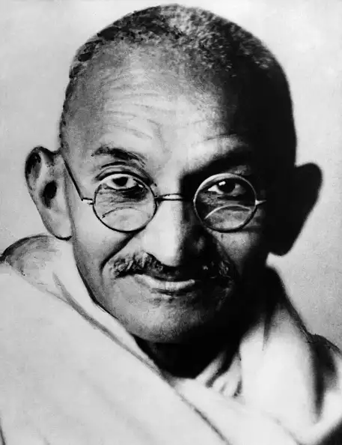
“Be the change that you wish to see in the world.”
PID Philippe Gerondal Past LCIF Trustee

