Slide 1
HUMANITARIAN AID LOGISTIC CENTRE
A PROJECT OF LIONS CLUB CLUJ TRANSILVANIA
DISTRICT 124 ROMANIA
PDG NIELS SCHNECKER EUROPA FORUM 2023 KLAGENFURT

Slide 3
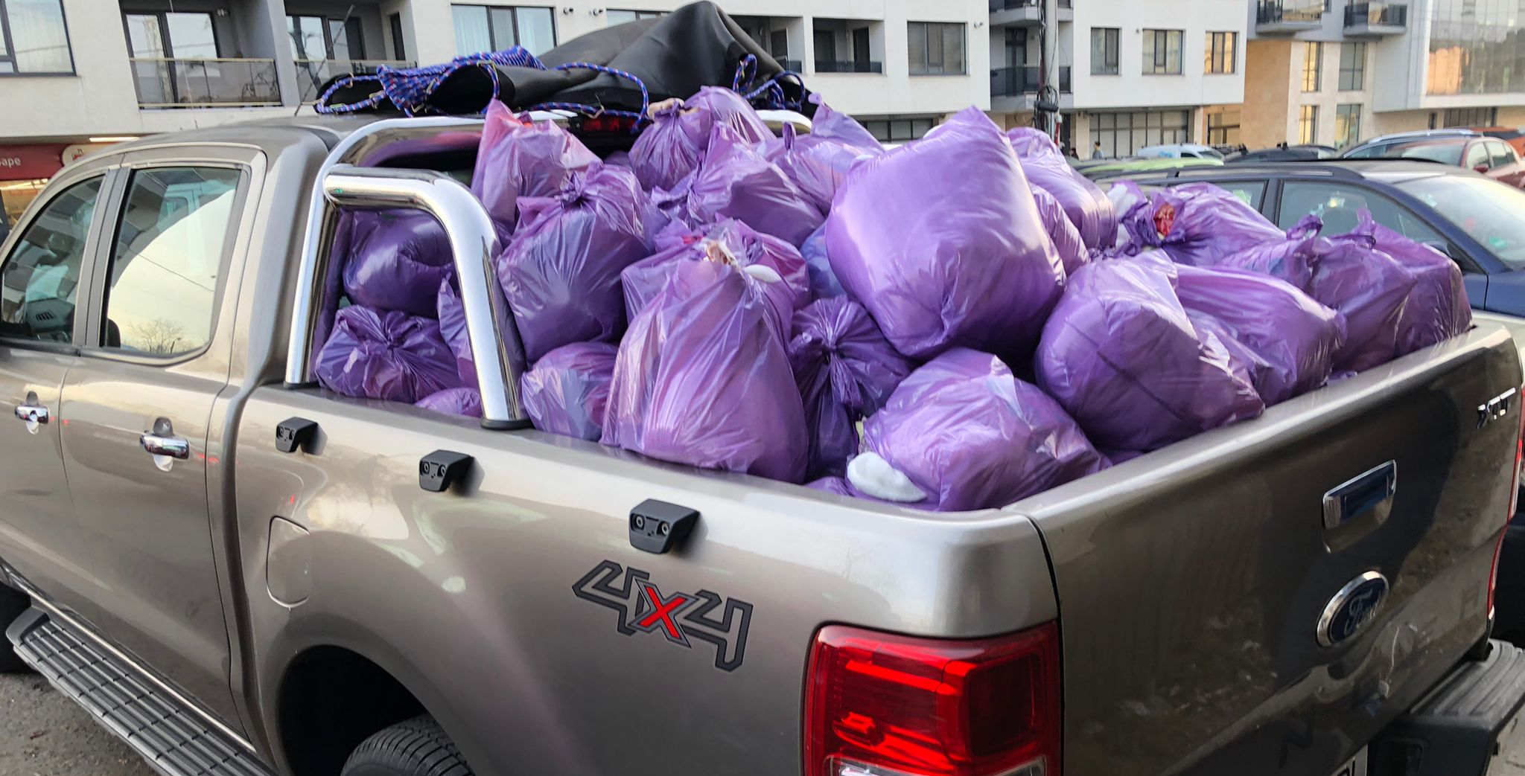

Slide 4
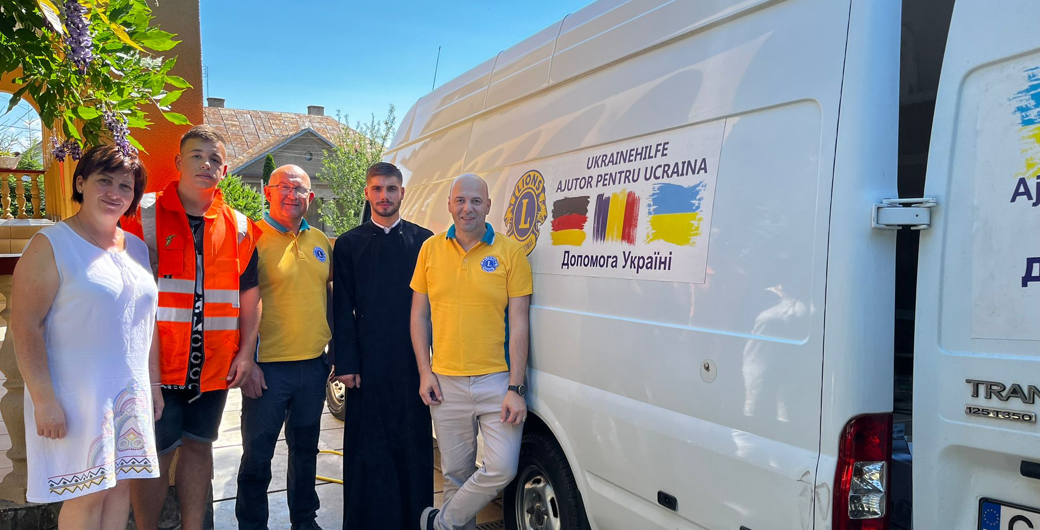

Slide 5
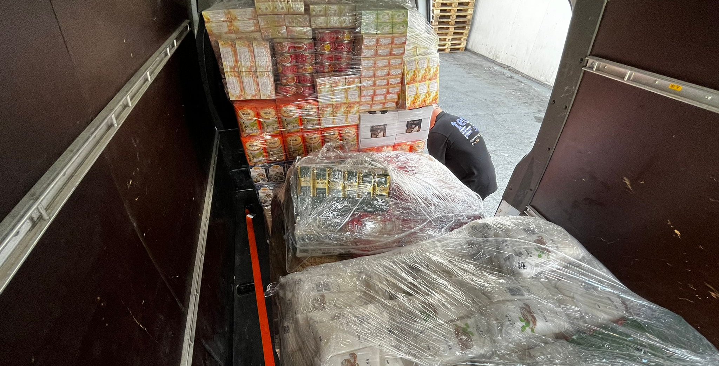

Slide 6
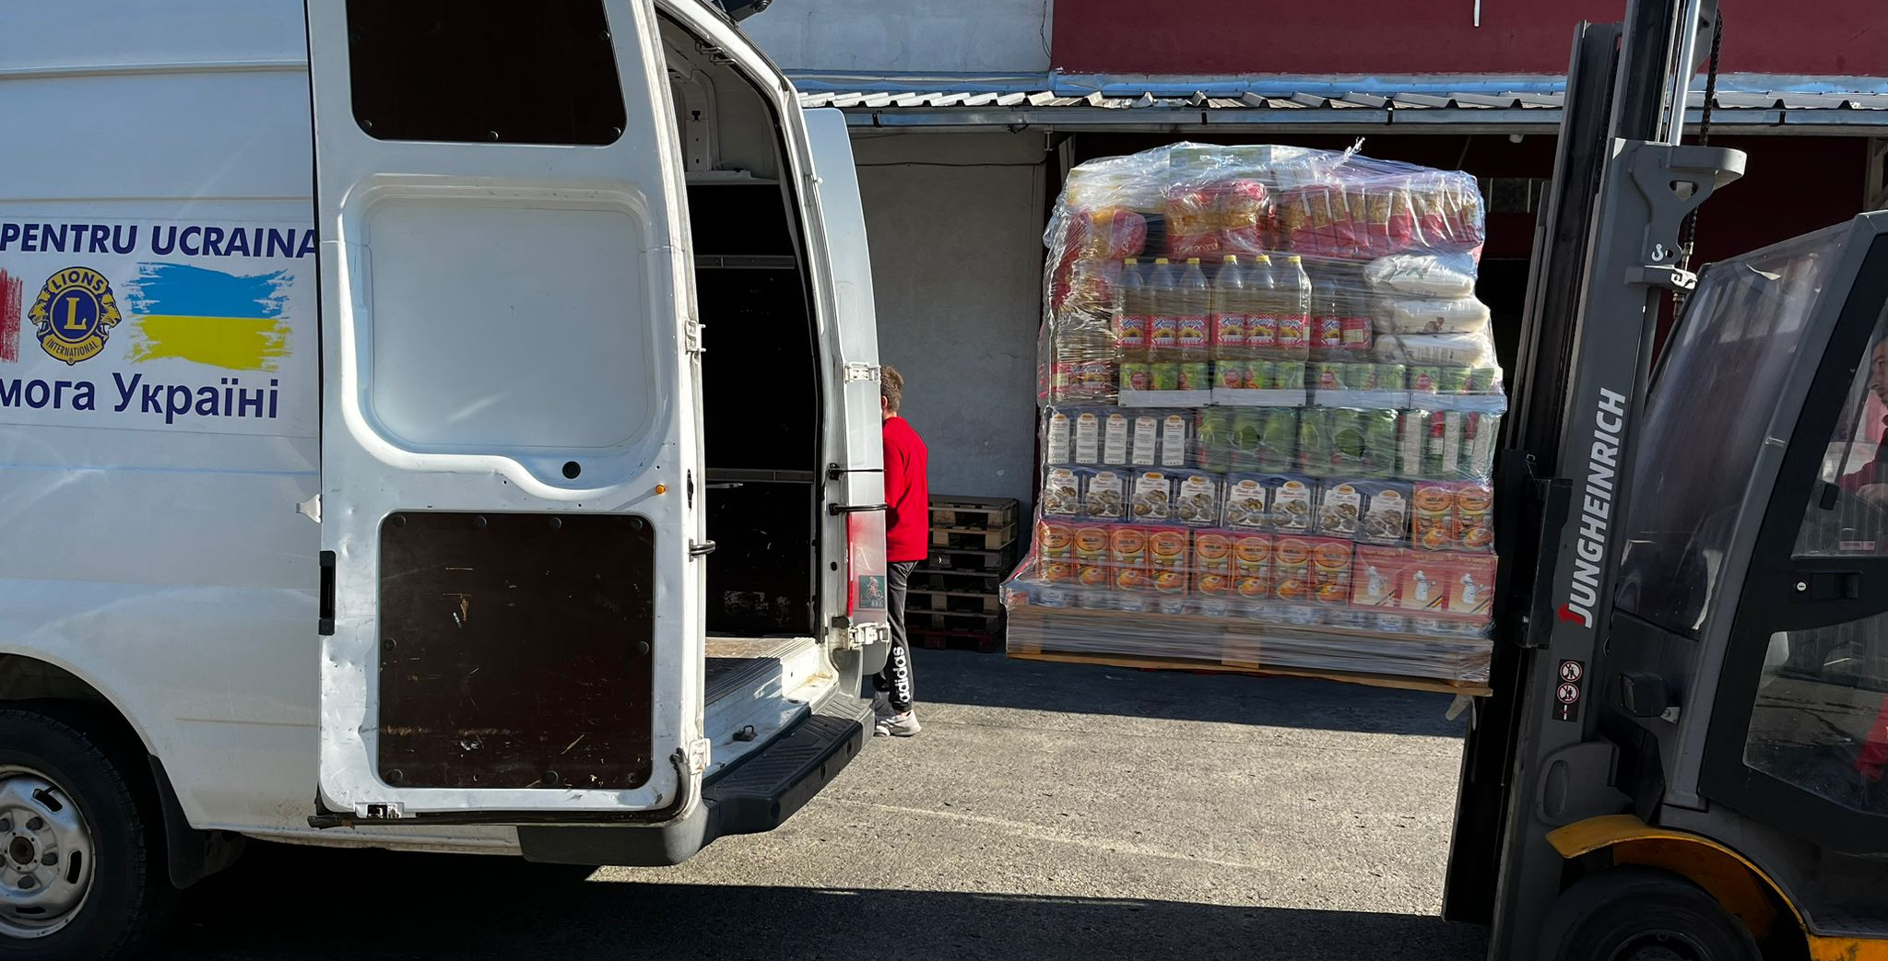

Slide 8
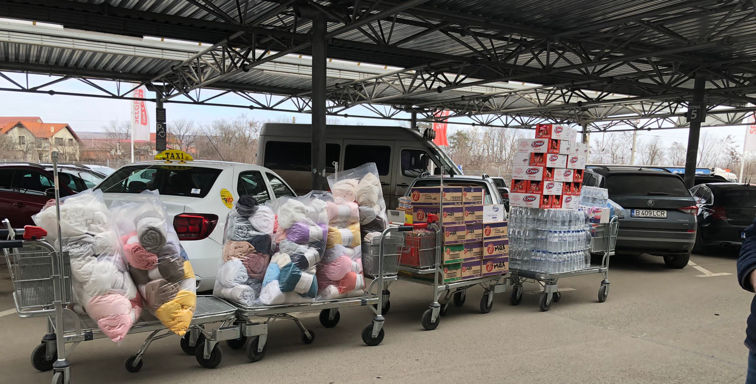

Slide 9
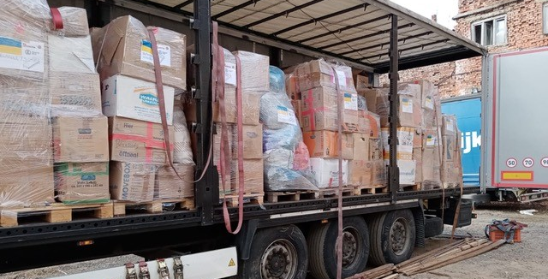

Slide 12
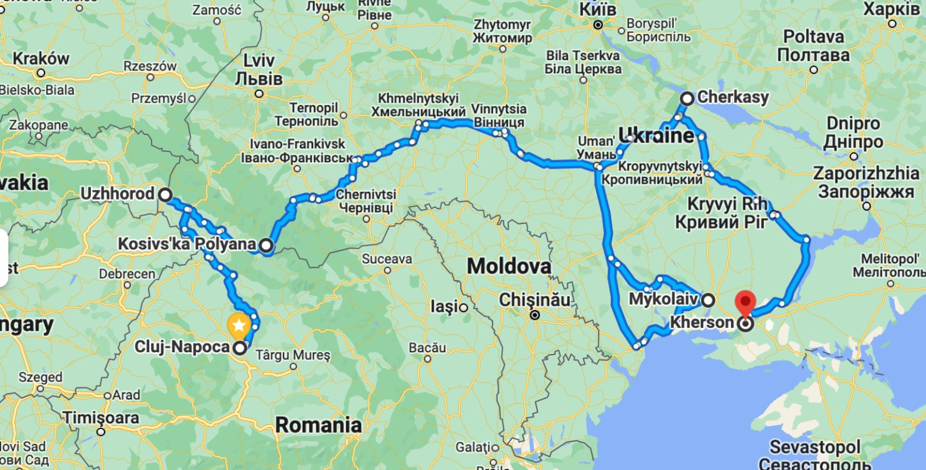

Slide 13
THANK YOU
PDG NIELS SCHNECKER
niels.schnecker@globalfininvest.com
PDG RADU CRISTEA
radu@pcdoctor.ro

