Slide 1
LCIF and District 134
Сooperation
District 134

Slide 2
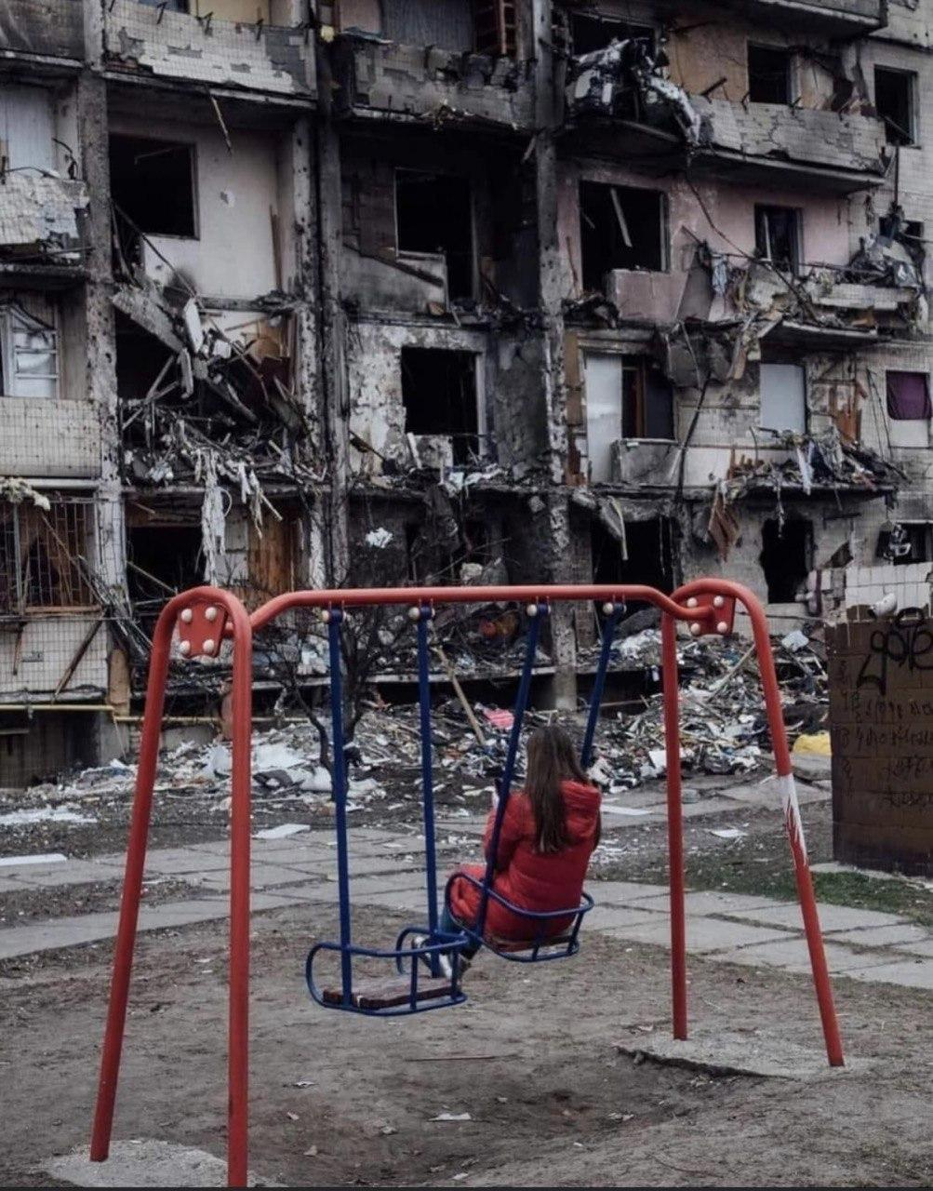
District 134
On 24.02.2022, the bomb and mussels attacks on Ukraine have started

Slide 3
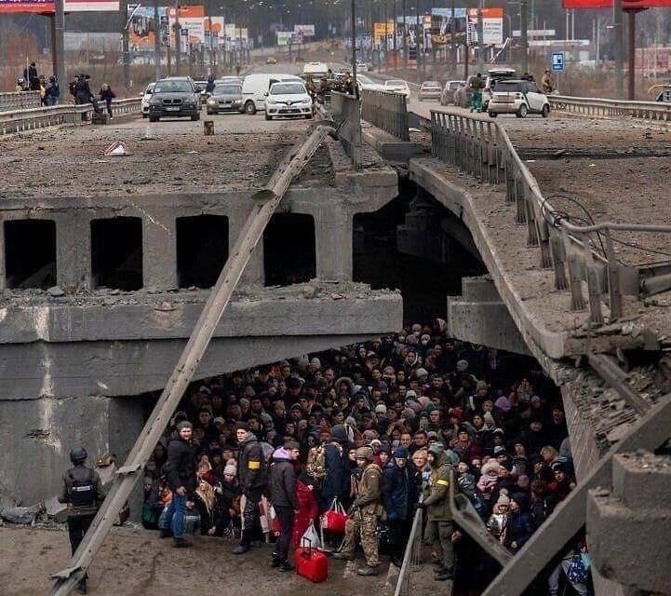
District 134
People moved to bomb shelters and on the west of Ukraine and abroad

Slide 4
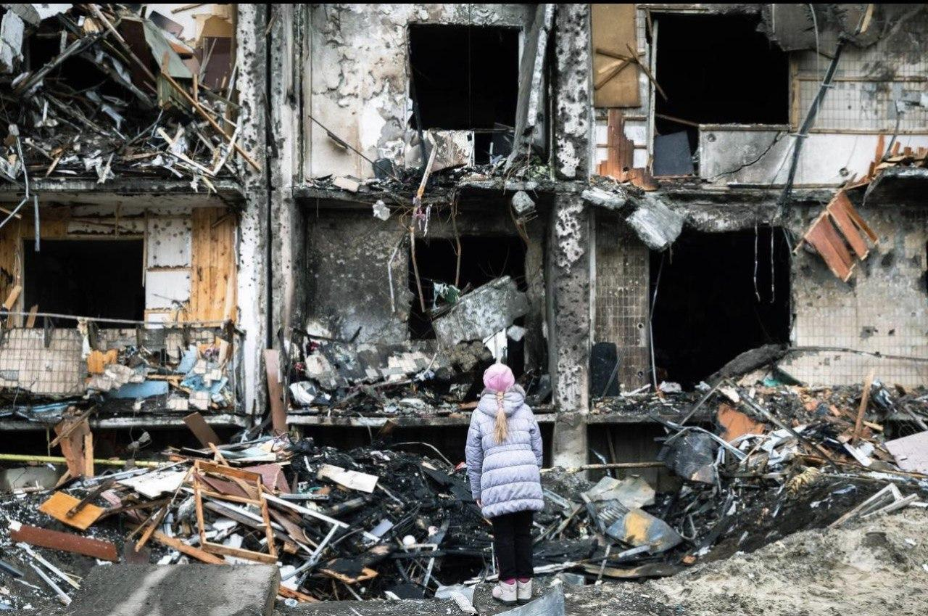
District 134
Thousands of buildings were destroyed. More than 10 million people left their homes.

Slide 5
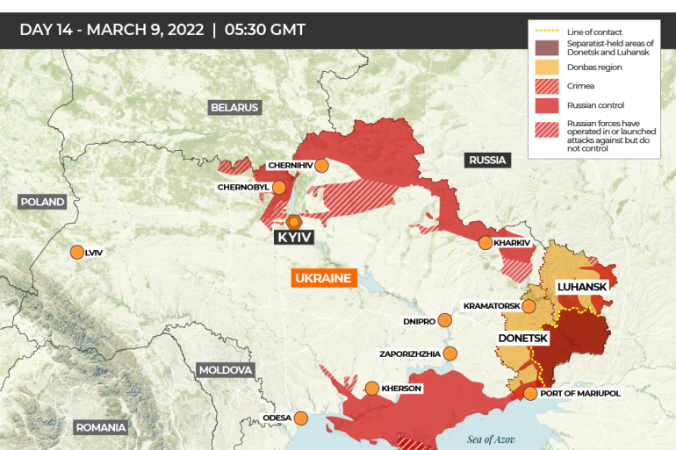
District 134

Slide 6
District 134
Emergency Grant Application process in 2022
3d of March 2023
4th of March 2023
7th of March 2023
9th of March 2023
The application to LCIF
for Emergency Grant support
The Application was approved
First LCIF Grant funds for food and medicines received
Grant is used to help internally displaced people

Slide 7
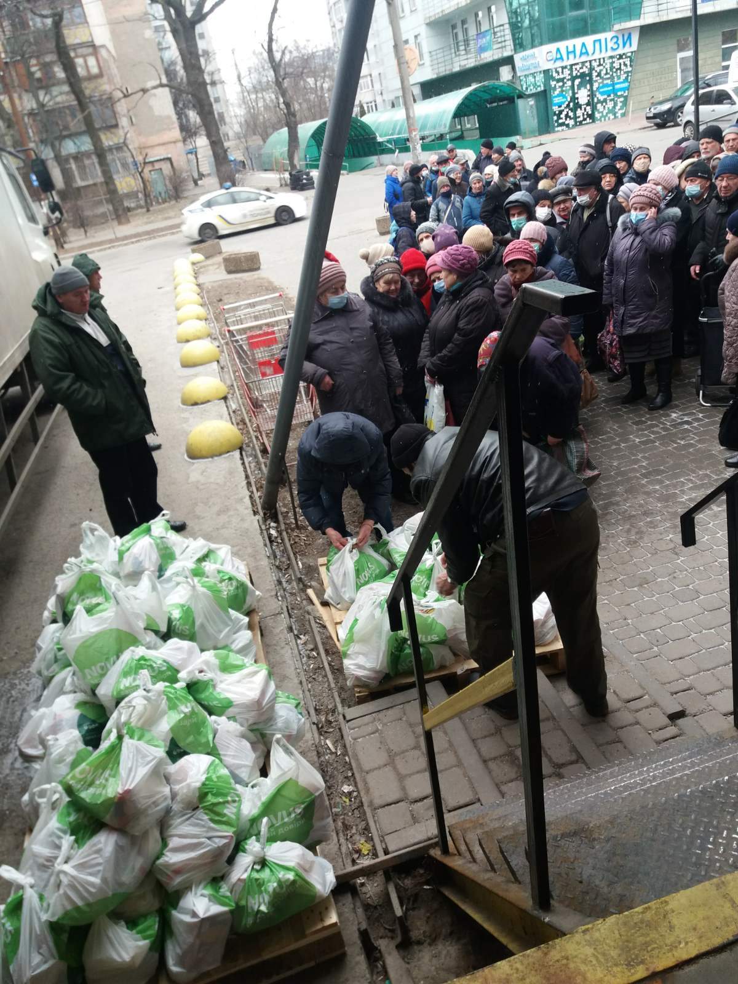
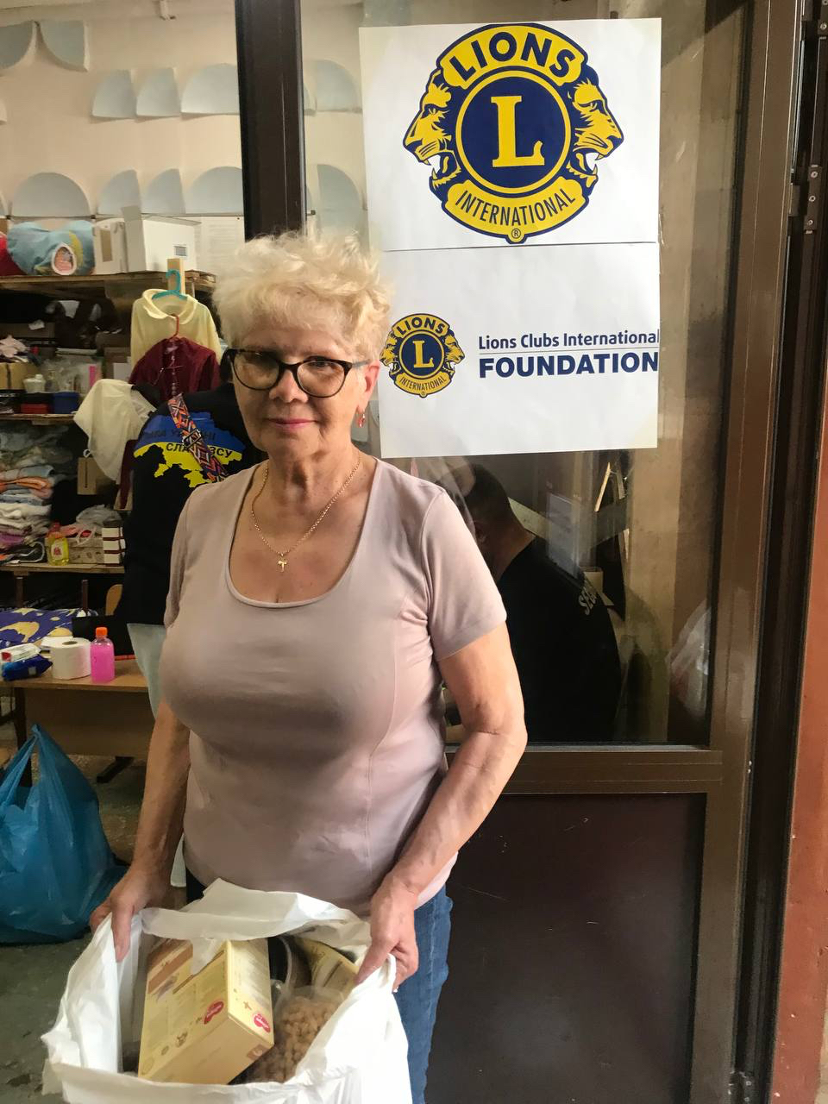
Prompt help to the internally displaced people
Focused on the essential needs of refugees
LCI and LCIF identification used while distributing
District 134

Slide 8
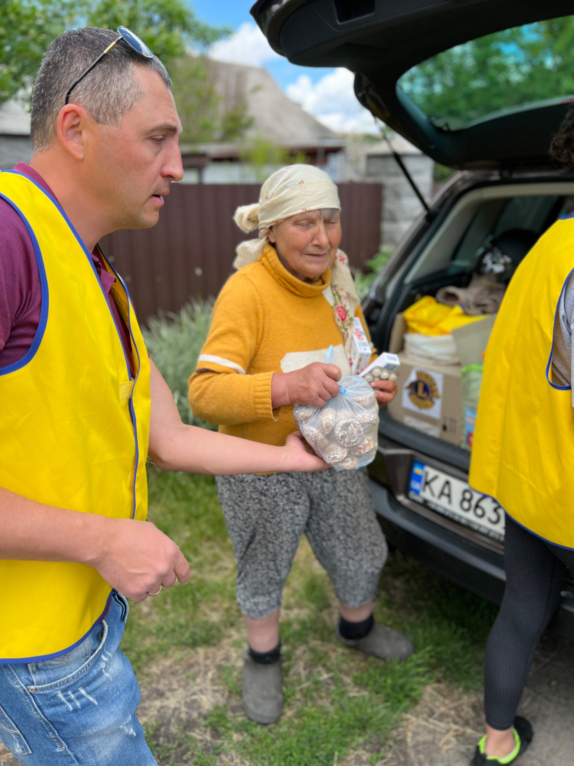
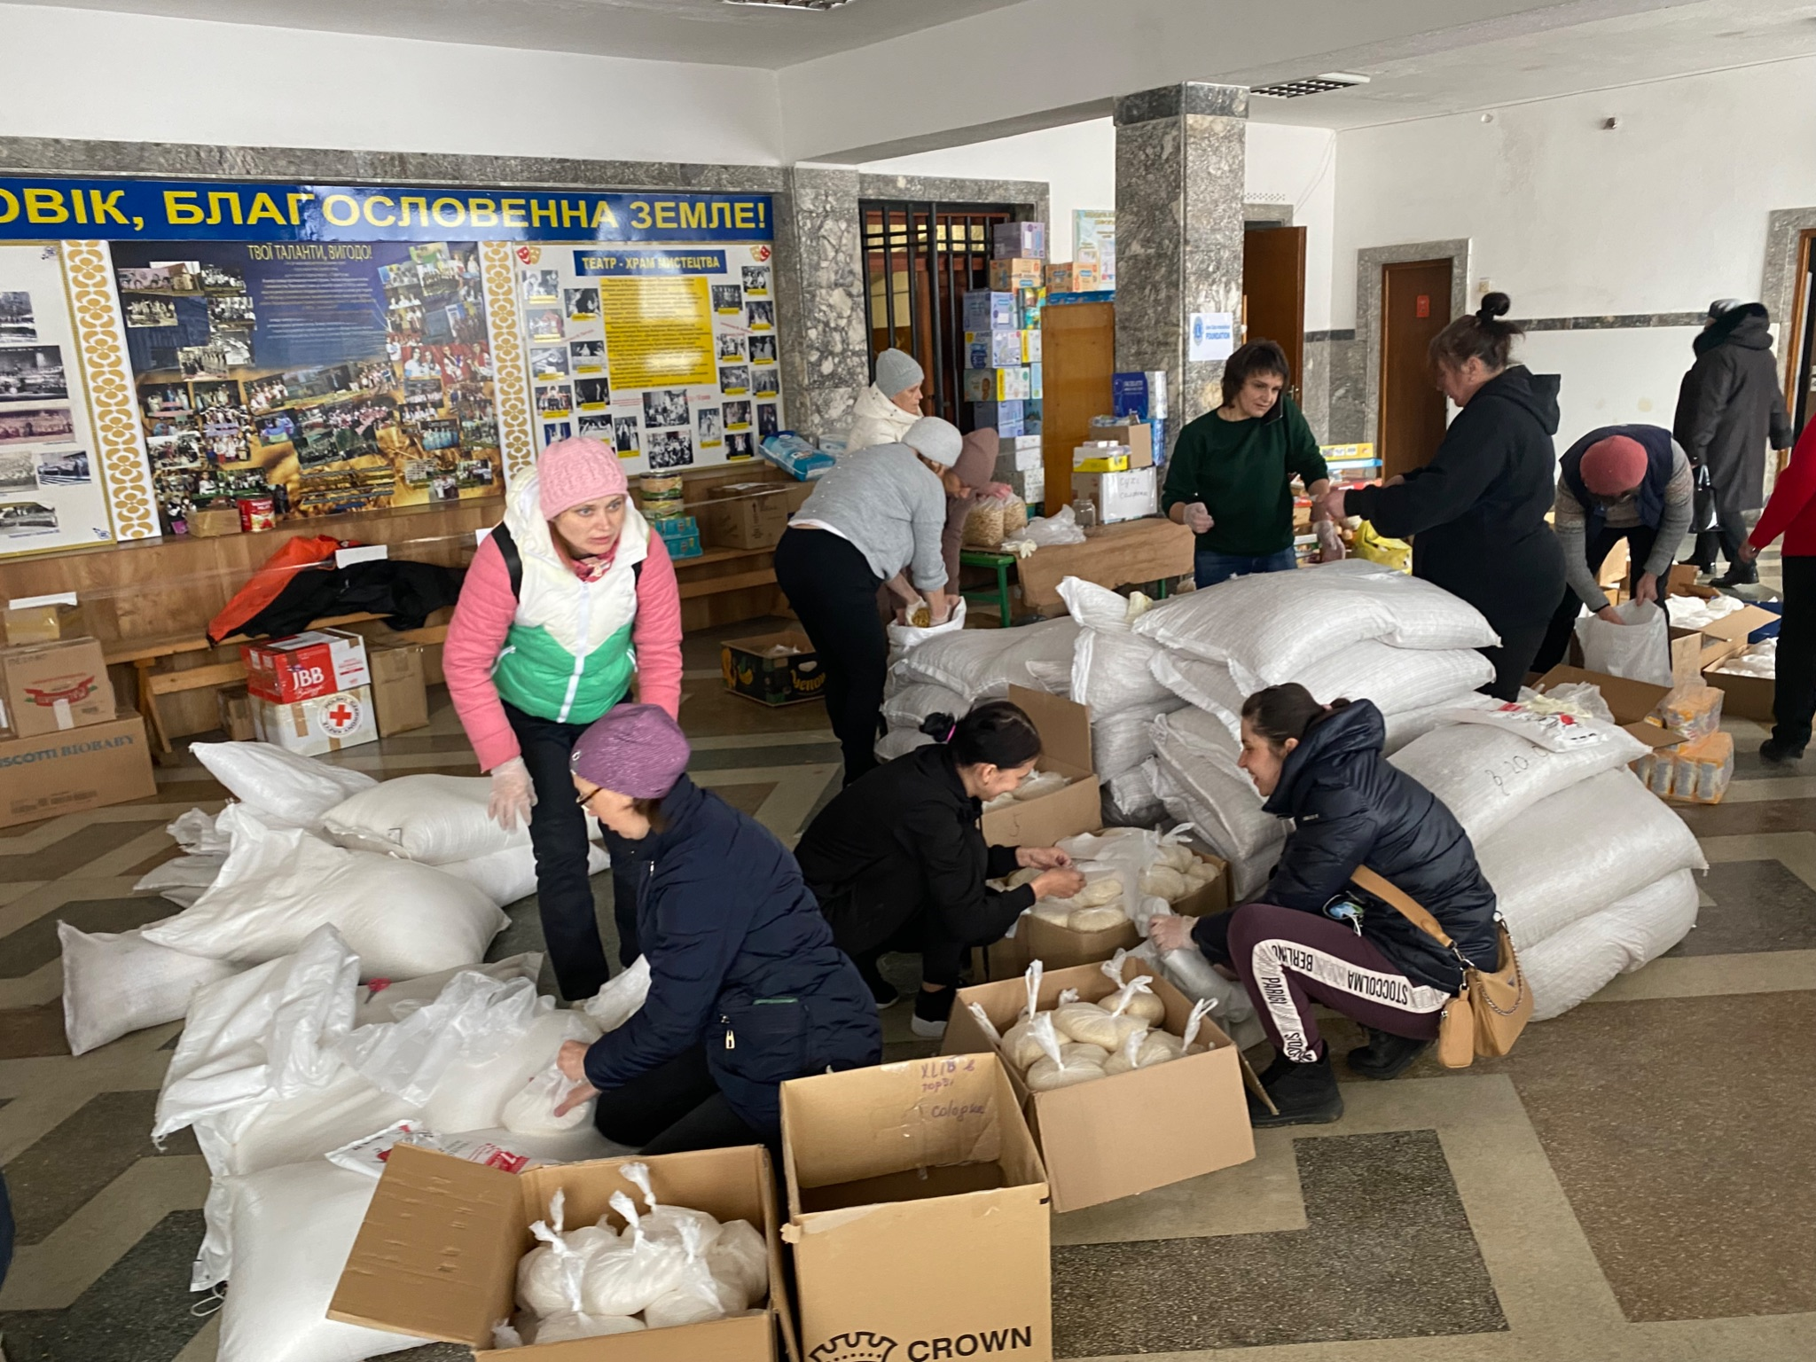
Lions built up the volunteer’s net for
food, medicines and essentials distribution
Distributed directly to the blocked Kyiv and later to Chernihiv, Bucha, Irpen
Lions work from the east to the west of Ukraine
District 134

Slide 9
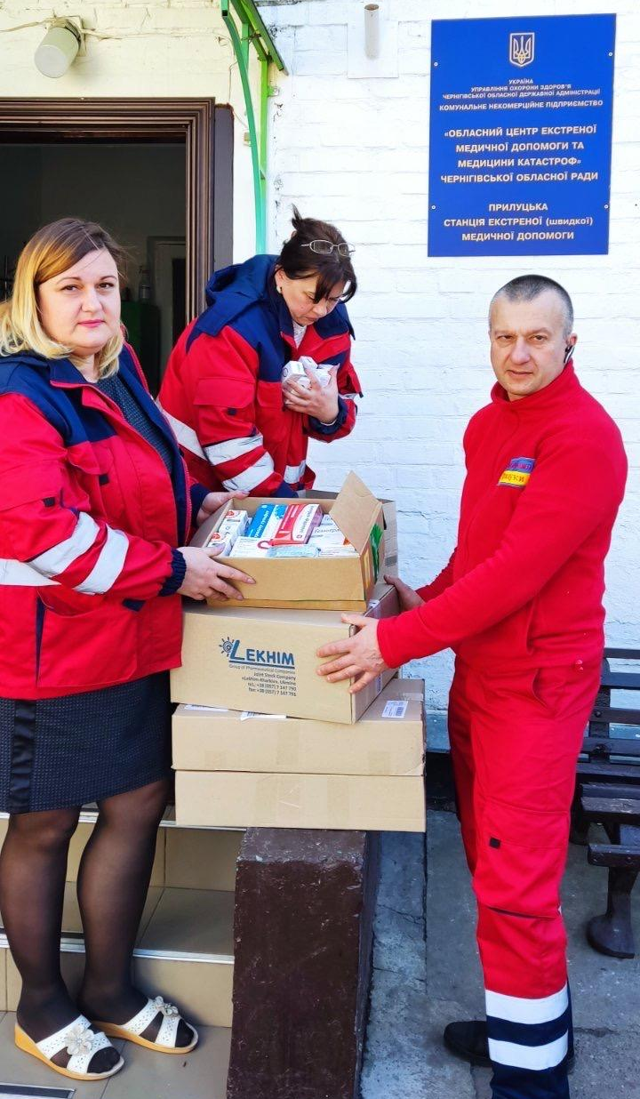
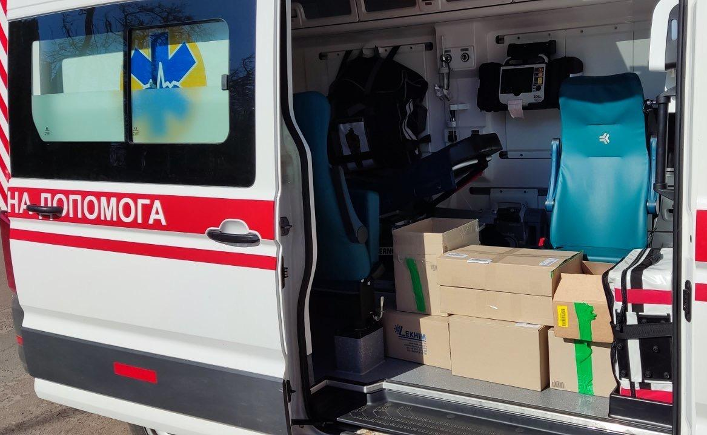
District 134
We help to the hospitals and emergence medicals with the medicines …

Slide 10
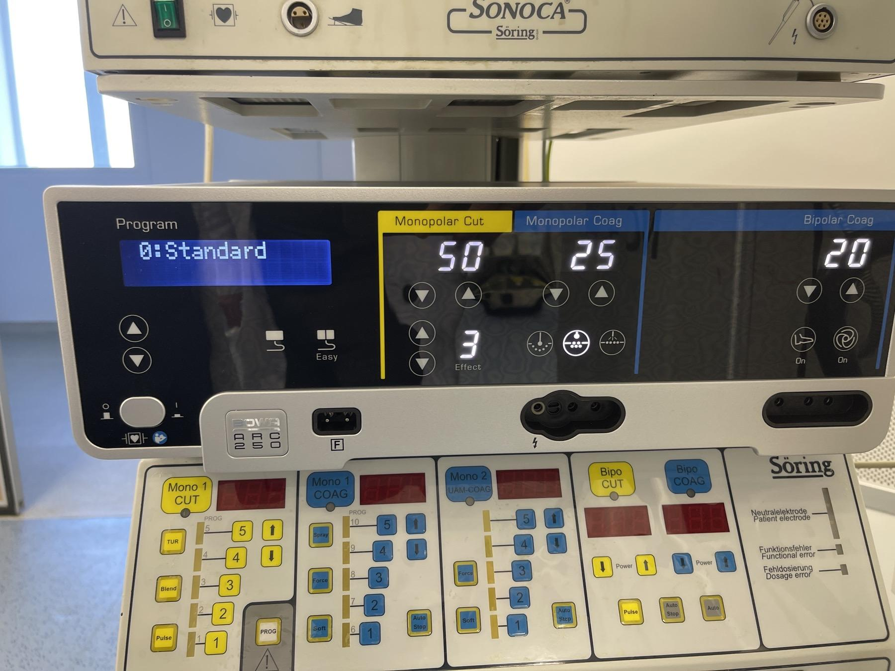
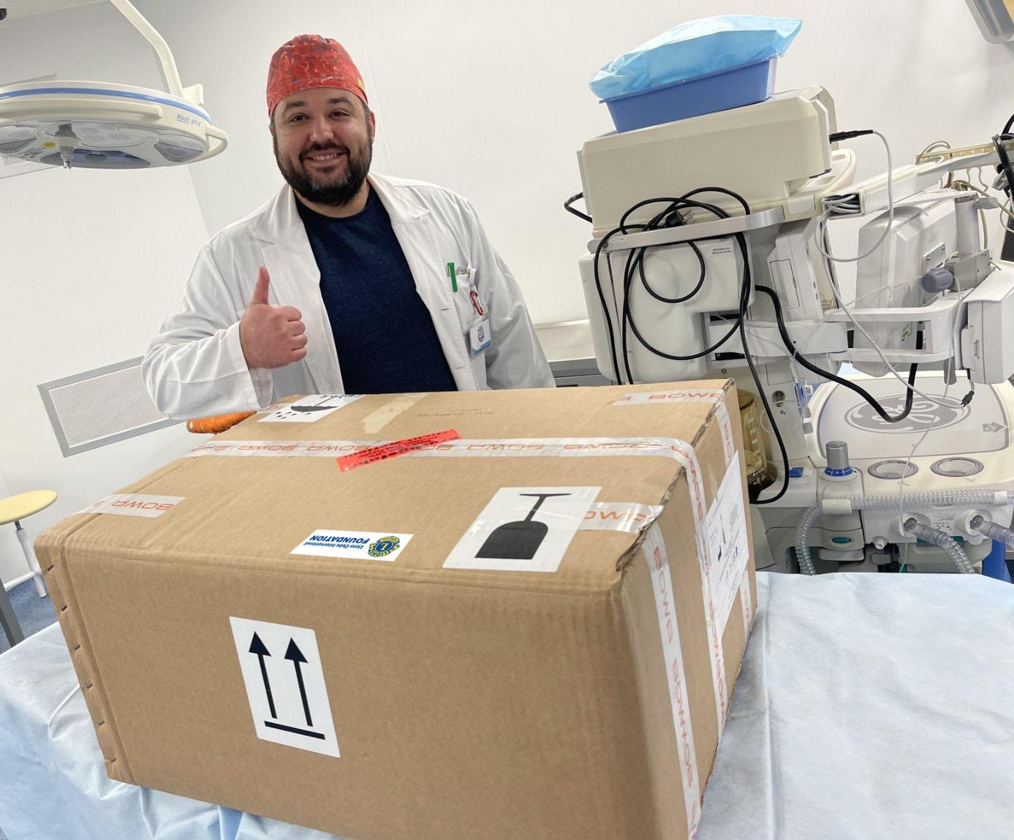
District 134
… and with the special equipment for children

Slide 11
District 134
We built up a net of volunteers

Slide 12
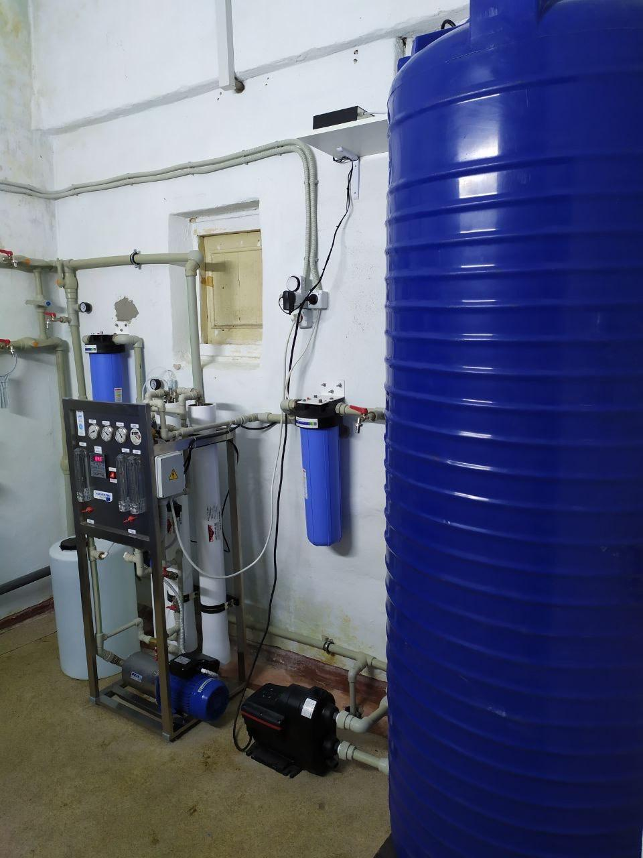
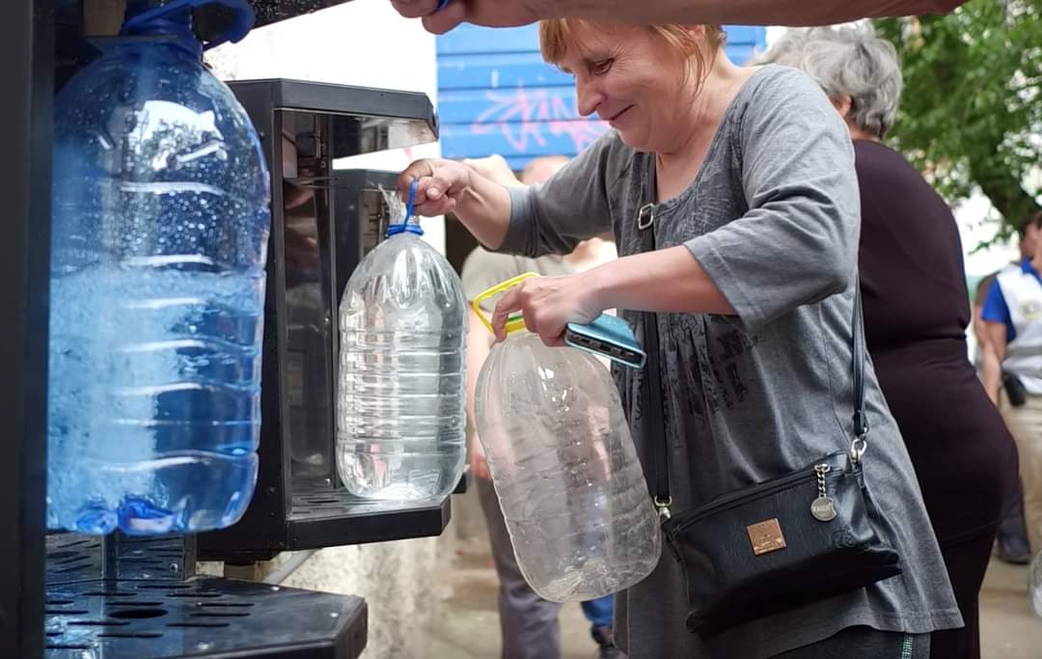
Clean water for Mykolaiv
District 134

Slide 13
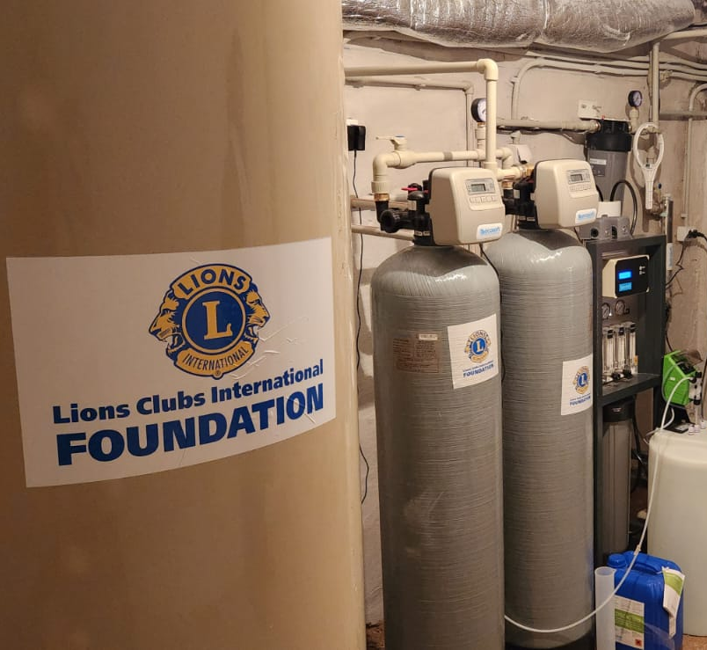
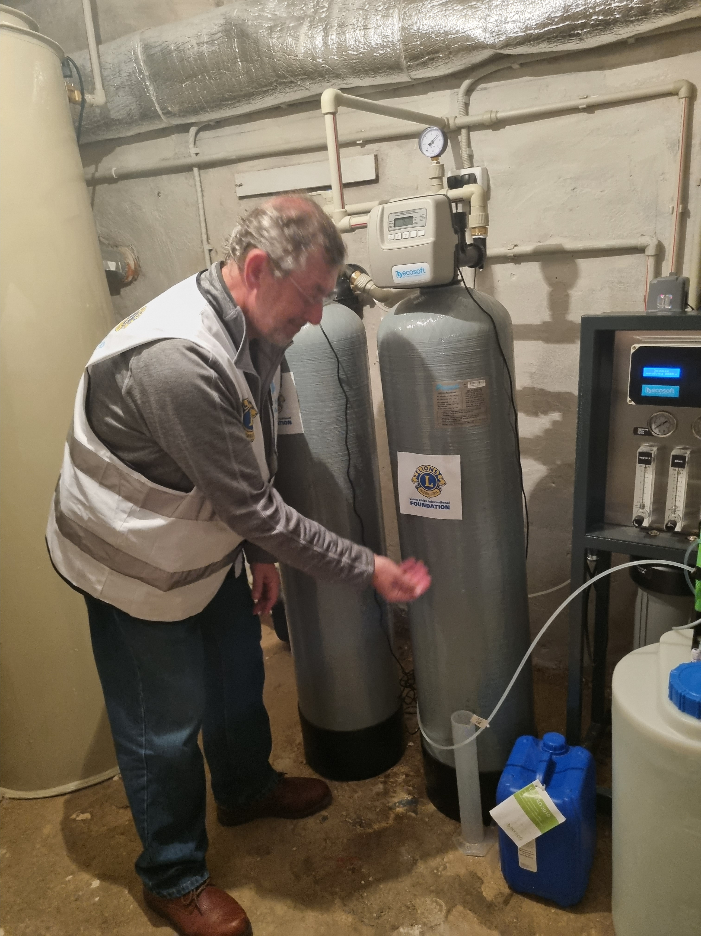
10 special osmosis systems were installed
in the different areas of the city for getting clean drinking water.
District 134

Slide 14
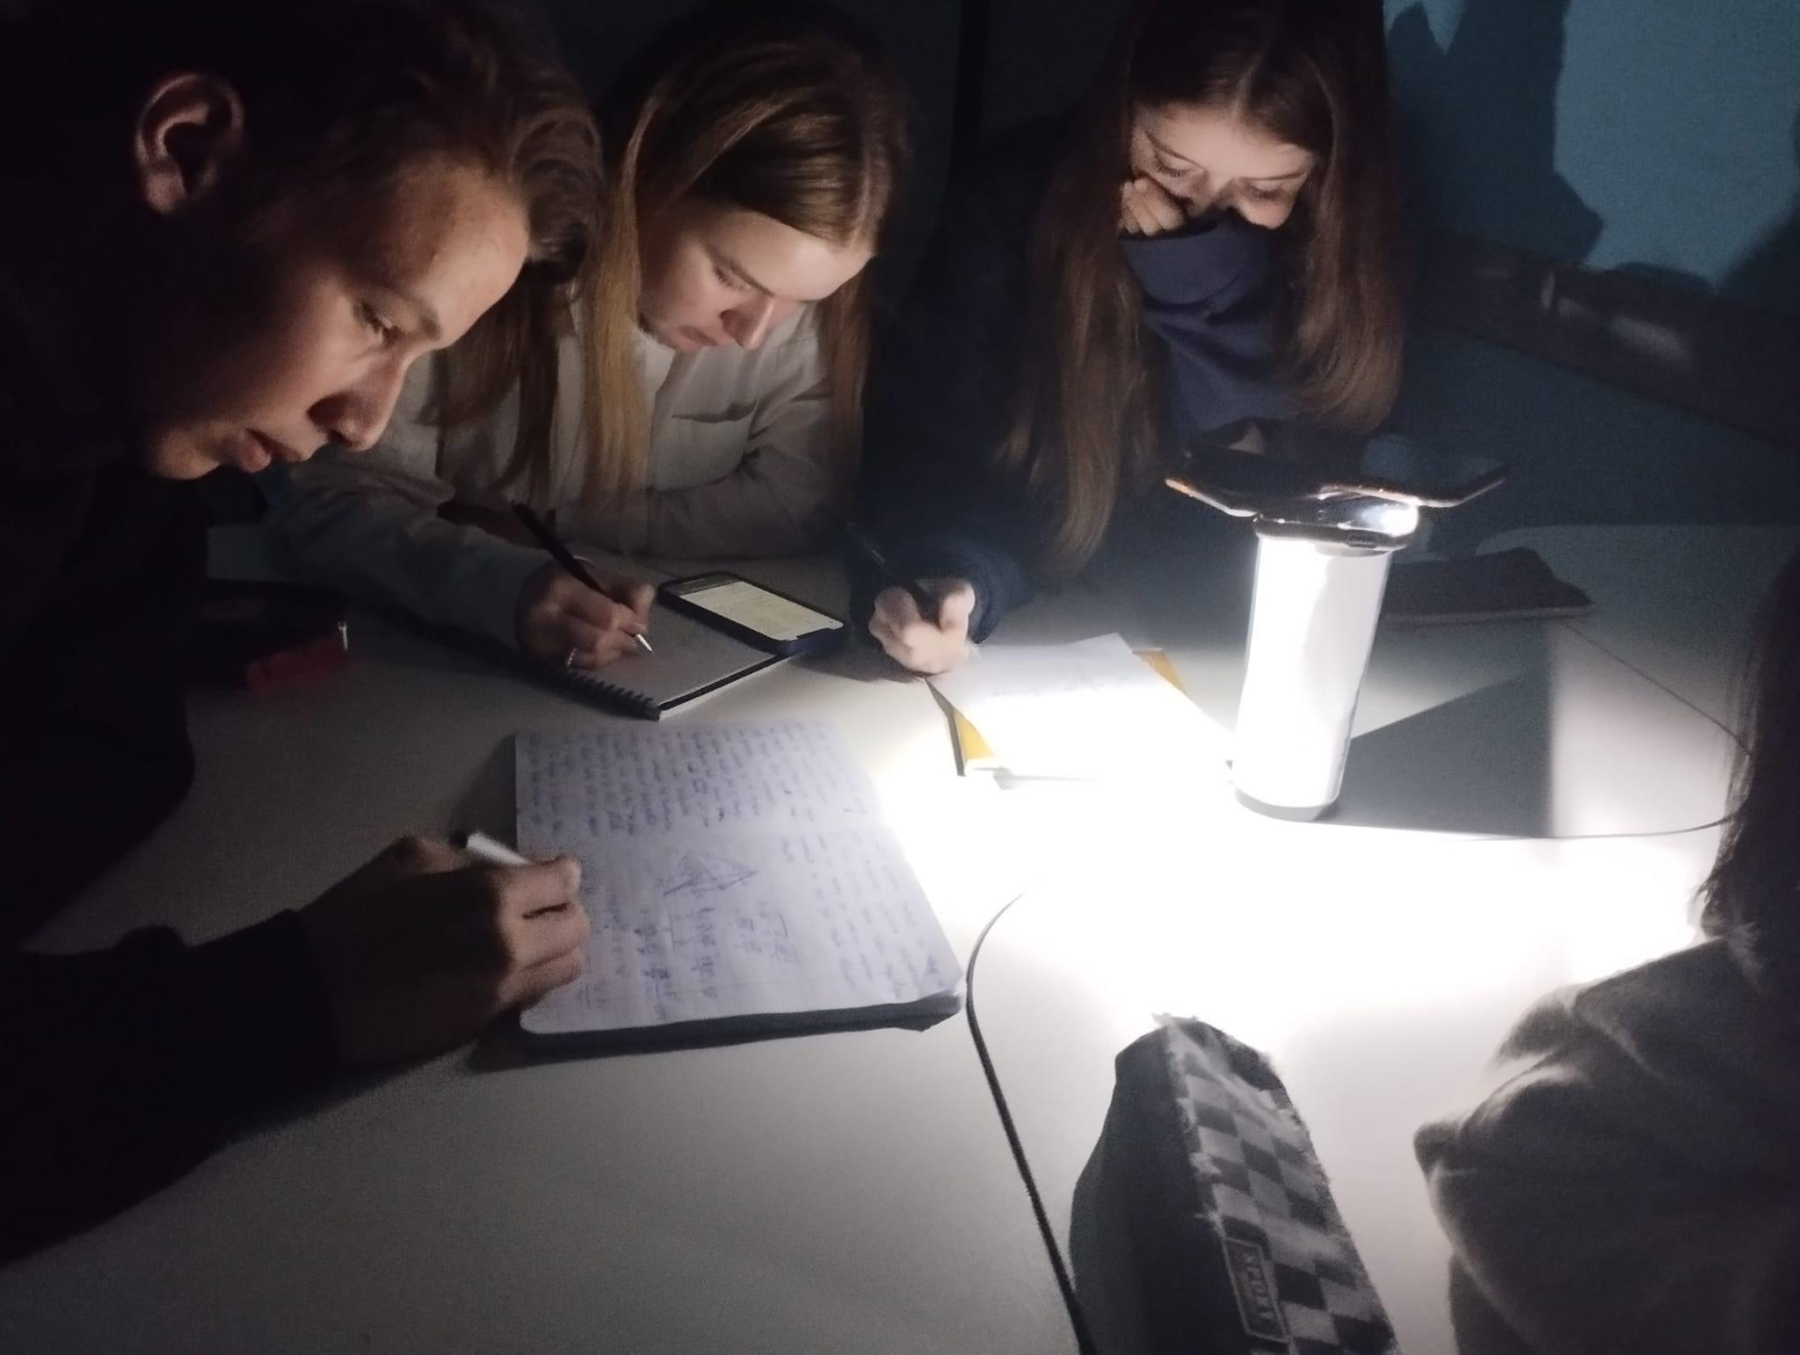
District 134
Children learning with no lights after blackout caused by missiles and drones attack

Slide 15
Project
“Winter is coming to Ukraine”
Generator project for schools, orphanages and kindergartens
Involved 13 countries
Gathered 1.5 million Euros
Bought and installed 2200 generators in 2000 schools
To provide transparency, detailed activity reports
sent to countries coordinators
District 134

Slide 16
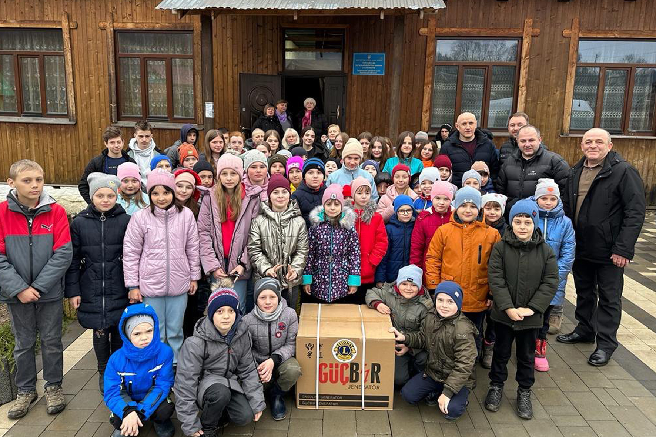
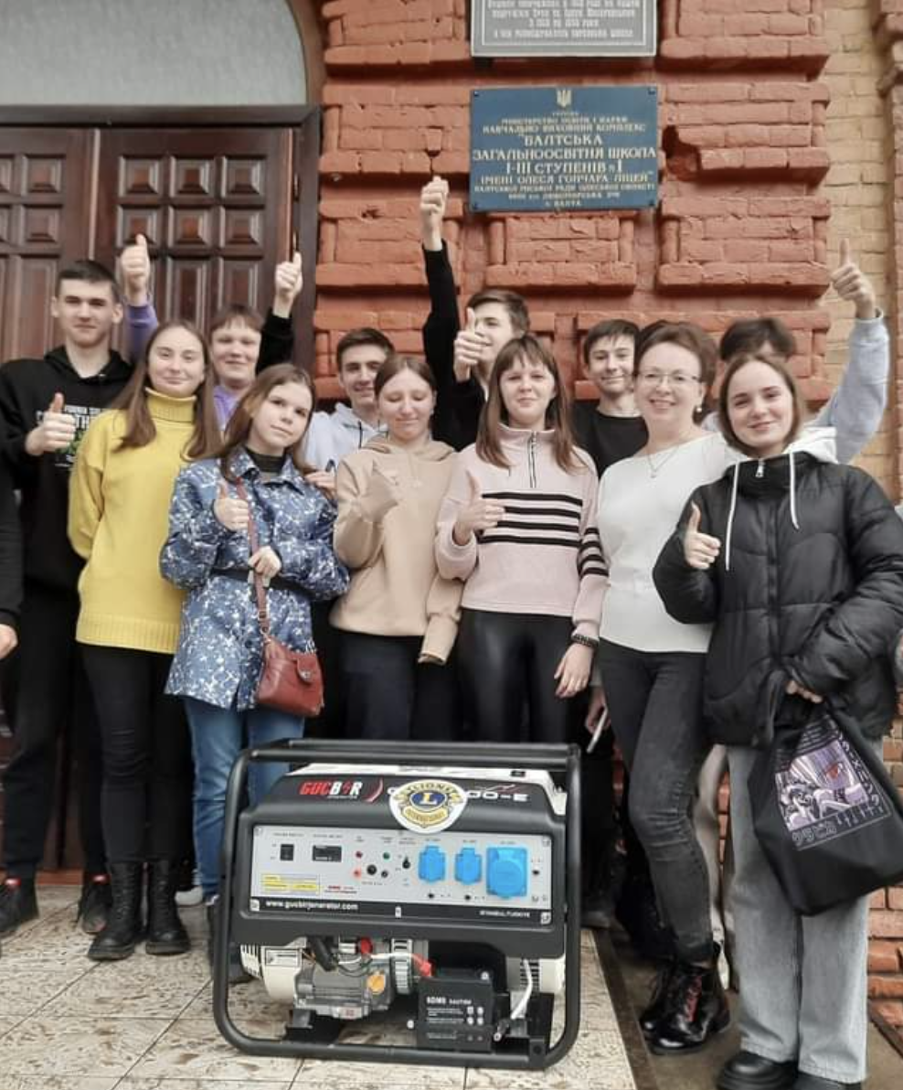
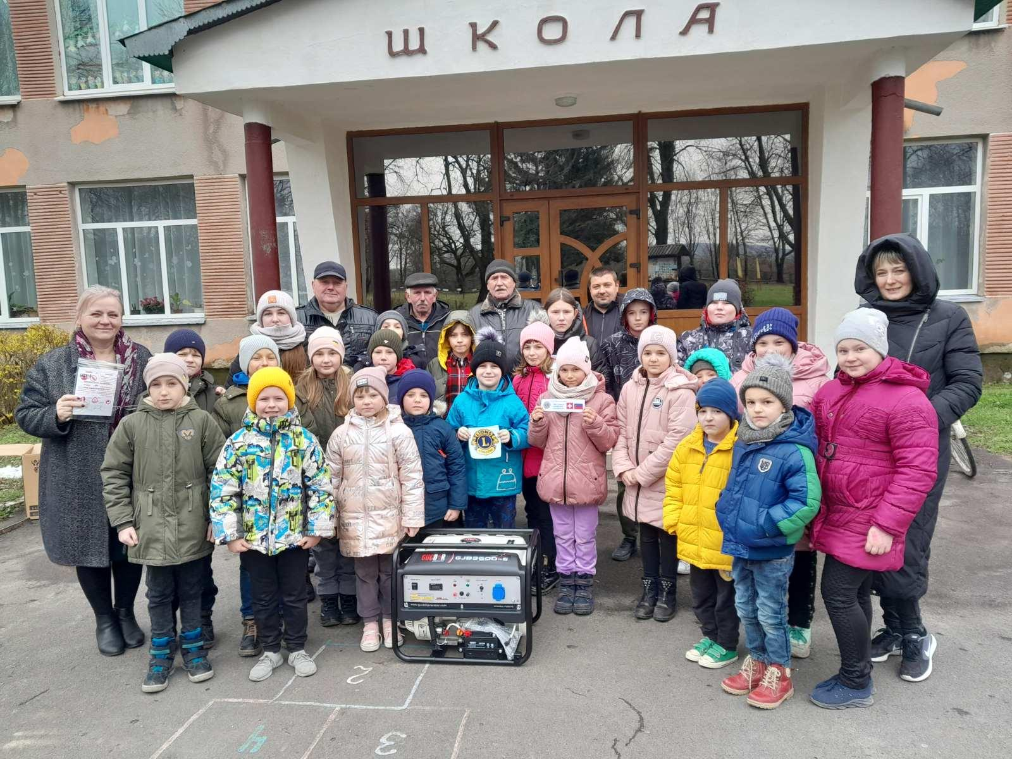
District 134

Slide 17
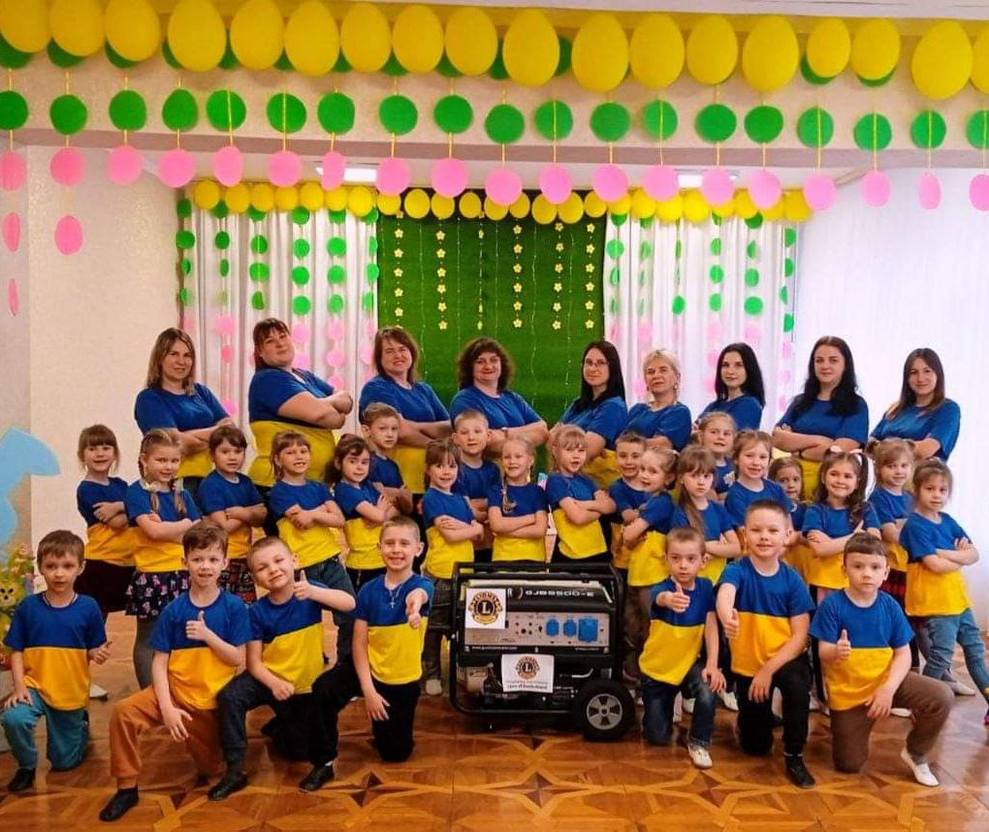
District 134
Happy children and teachers had got the generators
Special Letter of Recognition from a Ukrainian School

Slide 18
District 134
Founded 3 new Clubs
LC Kyiv Sova - central Ukraine
LC Kharkiv - eastern Ukraine
LC Skole - western Ukraine

Slide 19
Thank you!

